Slide 1
Building Relationships with Youth

Slide 2
Jack Kavanaugh, LMSW
Program Development Director WNY, Mentor New York
Notes:
3 minutes (3 minutes)
Brief welcome and introduction of facilitators
This training was developed by Mass Mentoring and MENTOR to capitalize on the power of all adults to develop the kinds of positive relationships with young people that help them thrive.
We know that coaches can be some of the most influential people in the lives of young people and we want to share some things that coaches (you) can put in their toolbox to really make the most of the time the young people you work with!

Slide 3
Notes:
10 minutes (13 minutes)
Now that you’ve gotten to hear a little bit about me, let’s take some time to get to know each other a little bit.
Everyone should have a piece of paper and a pen (either from their workbook, or you can hand out index cards or pieces of scrap paper).
Ask everyone to take a minute and write on their piece of paper the five things that are the most important things about themselves. After a few minutes, ask everyone to stand up and find a person to meet (hopefully, there are at least a few people in the room who they don’t know very well). Tell them that they are NOT ALLOWED to share with this person any of the five things that are on the card, but must try and introduce themselves anyway.
Once you’ve given the participants a few minutes to talk, ask the group:
Ask: How did it feel to introduce yourself to someone new without being able to talk about the five things with which you most strongly identify?
Answers might include: it felt a little weird, stunted, or that they weren’t able to show up as their whole selves.
Ask: How did it feel not to be able to show up as your whole self?
Say: one of the things that we know is critically important to building relationships with us is that they have to feel like they are able to show up as their whole selves with us. In order to do that, we need to recognize and understand that there may be things that we do and that others around us do that keep young people showing up as their whole selves- and that often, we aren’t fully aware of the things that we’re doing.
We’ll ask you, throughout this training, to try and keep this lens on- try to keep asking yourself about things that might be going on, in the program or in the world more broadly that are keeping young people from being able to comfortably be themselves. That we might be contributing in conscious or unconscious ways to young people not feeling safe. We want to try and stay reflective about this- to think deeply about our behavior.
A personal example may be helpful here:
Megan’s example: When I was a young coach, I realized that I was doing completely out of habit and with no recognition was that I was referring to an entire group of athletes, girls and boys, as “guys”. It was because when I was growing up, I mostly played sports with the boys and it’s just how my coaches always referred to me. I had to really think consciously about changing that so that the girls I was coaching didn’t think that I had a preference for the boys in the group. I just recently saw that you can now set an autocorrect on your phone to change “guys” to “folks”---if only I had had that when I was a young coach!
Dudney’s example: High school was the first time that I went to a predominantly white school. My family is Haitian and I grew up in a part of Boston, Mattapan, where most of the kids I went to school with were not white. When I arrived at BC High, it was a really confusing experience. I wasn’t sure if I was going to be able to talk about Haitian food with my classmates. I wasn’t sure if that was a part of myself that I’d be able to bring to that part of my life.
These are the kinds of questions we always want to be thinking about when working with young people- what might we be doing that’s contributing to making sure our young people always feel like they can be themselves with and around us.

Slide 4
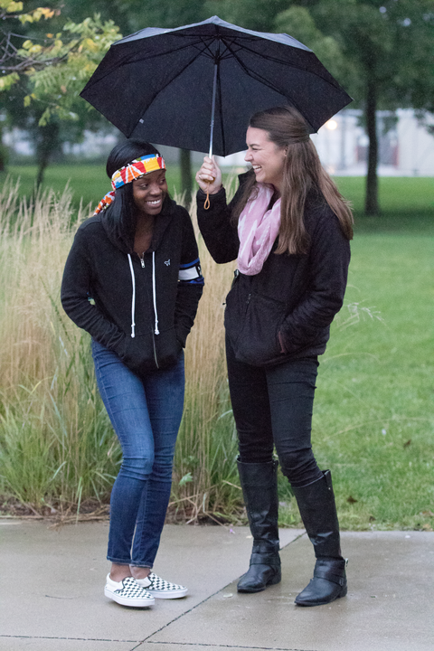
Think about the ways in which relationships help drive growth
Explore the Developmental Relationships Framework for helping youth thrive
Practice some tangible strategies so you can put this framework into action.
TODAY
Notes:
2 minutes (15 minutes)
With that critical lens on, we’re going to spend the rest of this training doing the following:
Think about how important relationships are in the success of coaches helping young people develop
Explore the “developmental relationships framework” which is a cornerstone in the mentoring field that helps guide the creation of relationships in which young people don’t just develop, but thrive, and
Brainstorm and explore some concrete strategies that you can use to create these developmental relationships with the young people you work with!

Slide 5
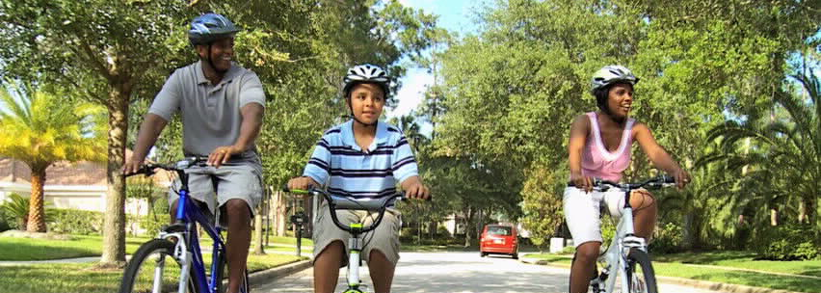
THINK
BACK
Notes:
5 minutes (30 minutes)
Activity, Part 2
Now ask the whole group to take a minute and think about HOW they learned this thing (or believe that someone else learned this thing- what did it take for this outcome to be achieved?)
Transition into the HOW- the Coach. In almost all cases, there’s a “someone” who teaches these things. Someone who guides the learning in a way that helps draw out what’s important in the moment, what learning is important for us to take with us as we leave the sports experience. With sports, we sometimes think that kids will learn things just by participating. And maybe, in some case, that’s true. Maybe there are kids who are part of sports who are good at picking up the learnings on their own. But I bet we can all think of a kid for whom that isn’t true- and that’s why we need a coach. The coach can make sure that all kids always see the learning opportunities. The coach can provide the opportunities to be engaged in the sport, to learn, to want to stay in the sport, etc. Without the coach, the outcome is not as likely- sometimes it happens by accident, but we want to make sure that it ALWAYS happens for EVERY young person. And that happens through the relationship between the coach and young person.

Slide 6
Defining Mentorship
What is a mentor?
What isn’t a mentor?
What roles to mentors fill?

Slide 7
ADOLESCENTS (Ages 11+)
Notes:
Insert 1 of 4 modules:
Adolescent Module: 15 minutes, 5 slides (65 minutes)
Older Children Module: 9 minutes, 3 slides (59 minutes)
Young Children Module: 9 minutes, 3 slides (59 minutes)
All Age Module: 21 minutes 10 slides (71 minutes) all slides except first Coach Out Loud slide (use one for both adolescents and older children)
Adolescent Module: 15 minutes (65 minutes)
3 mins
We know that adolescents is an important time for young people and that there can be a lot going on for them. Let’s talk about that. What’s going on for them?
(Encourage coaches to talk about all of it- the good, the bad, and the smelly. Yes, young people often smell and sometimes we’re the only people who can talk to them about it).

Slide 8
THEIR BODIES
Big hormone increase, growth spurt
Fine motor skills improve at faster rates for boys than girls
Girls add body fat, boys add muscle
THEIR COMMUNITY
Want increased autonomy
Peer Pressure and interest in conformity increases
Relationships become stronger and last longer
THEIR FEELINGS
Increases in moodiness, intimacy and loyalty
Highly impulsive and risk-taking
Notes:
3 mins
Reveal some of the things that are going on with their bodies (their physical development) , their team (their social development), and their feelings (their emotional development).

Slide 9
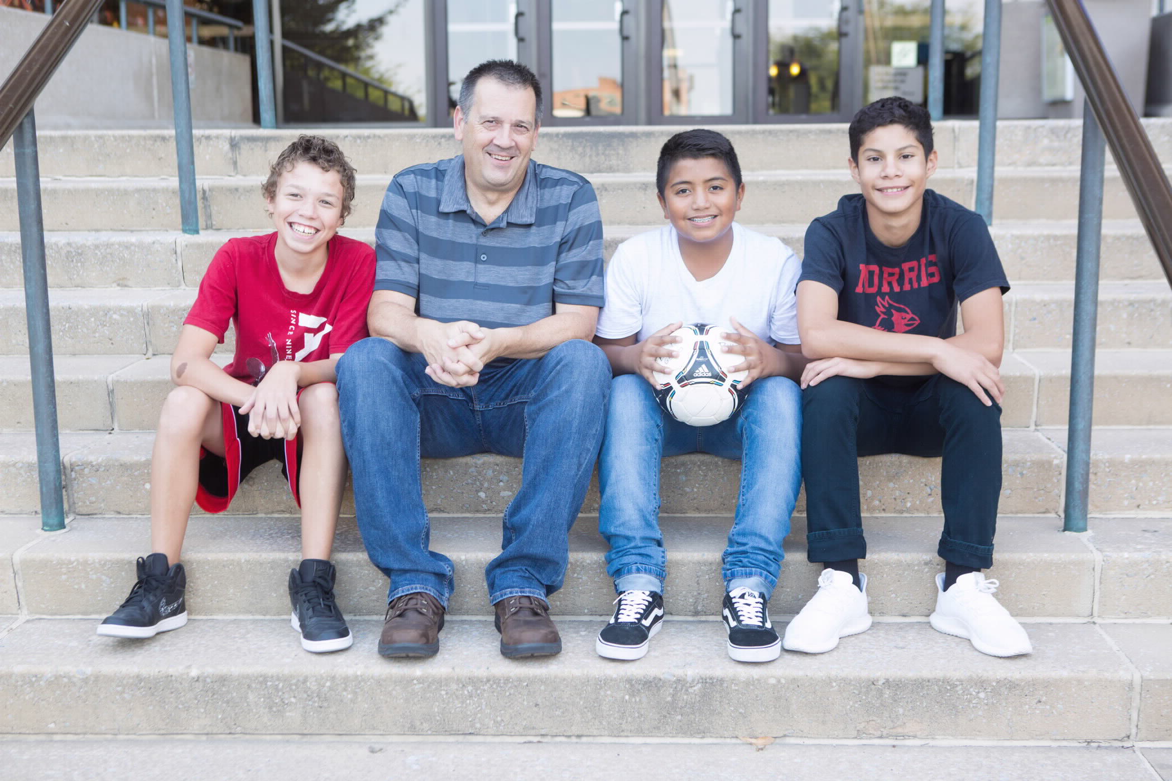
OLDER CHILDREN (Ages 6-10)
Notes:
Older Children Module, 9 minutes (59 minutes)
3 mins
If this is the primary age group we’re working with, what do we see that it’s going on with them?

Slide 10
THEIR BODIES
Like games with rules and contact
Improved body control, accuracy, speed and reaction times
For some, bodies start to change; curious about changes
THEIR COMMUNITY
Start to understand morel rules
Building sense of social norms and individual rights
School, physical appearance and sports impact their self-esteem
THEIR FEELINGS
Emotions like guilt and pride begin
Become capable of many emotions at one time
Focus on relationship between self and others
Notes:
3 minutes
Reveal some of the things that are going on with their bodies (their physical development) , their team (their social development), and their feelings (their emotional development).
Why does this matter? Hopefully, it helps us understand that it’s normal for kids to still be developing some of the skills we want them to be able to display as coaches. That their behavior may be driven more by the developmental stage they are in and less by an intention to ruin our day.
If we know more about where they are, we can make adjustments that help us accommodate for the things they are good at and the things that they still need to develop.

Slide 11
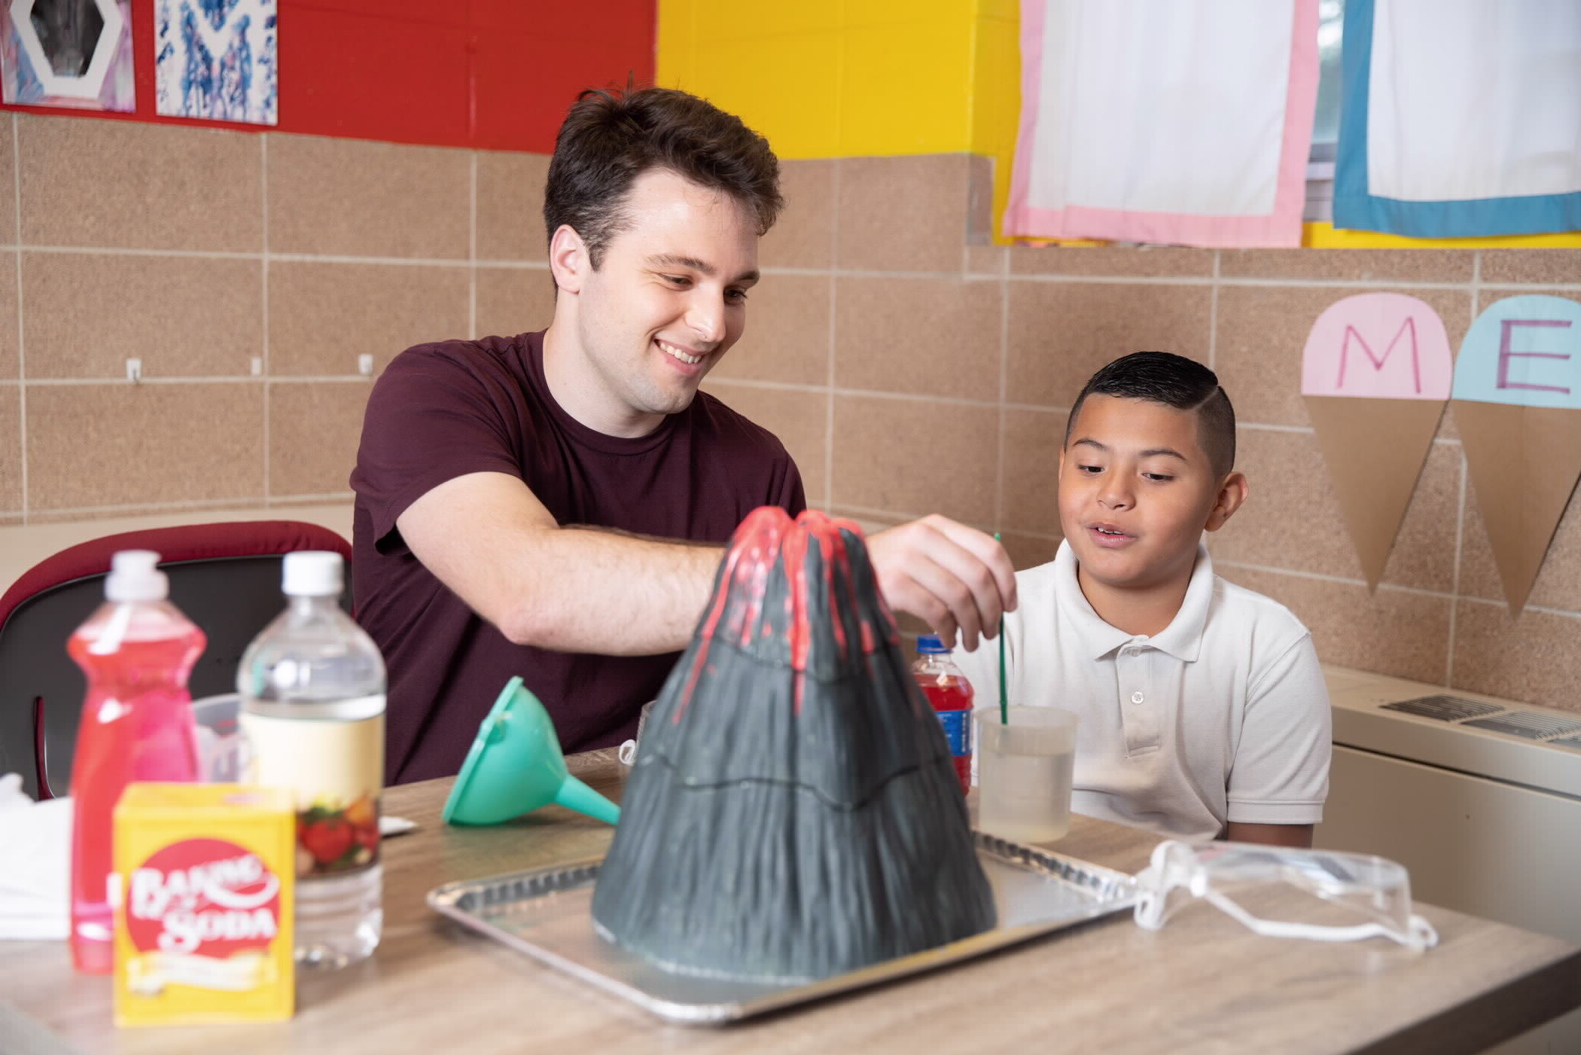
YOUNG CHILDREN (Ages 2-6)
Notes:
Younger Children Module, 9 minutes (59 minutes)
3 mins
If this is the primary age group we’re working with, what’s it like to be working with this younger age group?

Slide 12
THEIR BODIES
Begin to run
Learning to jump, throw, catch
Developing coordination of movement
THEIR COMMUNITY
Start playing as a group
Kid to kid relationships begin
Begin to develop morals
THEIR FEELINGS
Learning to control self and emotions
Understand causes and consequences
Increase in empathy
Shorter attention spans
Notes:
3 mins
Reveal some of the things that are going on with their bodies (their physical development) , their team (their social development), and their feelings (their emotional development).
Why does this matter? Hopefully, it helps us understand that it’s normal for kids to still be developing some of the skills we want them to be able to display as coaches. That their behavior may be driven more by the developmental stage they are in and less by an intention to ruin our day.
If we know more about where they are, we can make adjustments that help us accommodate for the things they are good at and the things that they still need to develop.

Slide 13
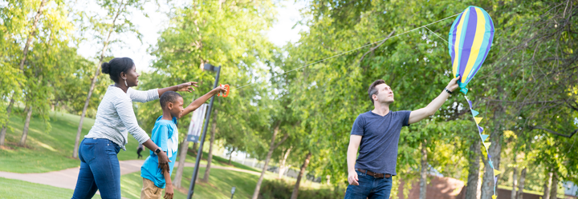
“Developmental relationships are close connections that powerfully and positively shape young people’s identities and help them develop thriving mindsets”
Notes:
2 minutes (90; 84; 96 minutes)
Here’s how we’re going to do it. We’re going to share this framework so that we become more mindful and intentional in developing relationships with young people that really help them heal and thrive.
Give overview of the Search Institute- review the development of the 40 Development Assets and how it has led to looking deeper into the relationships that young people have with caring adults. As Kent Pekel, the executive director of the Search Institute has said- Search is interested in looking into the “black box” of youth and adult relationships and seeing what is going on and what really makes the difference- diving deeper and understanding more about what happens in these relationships.

Slide 14
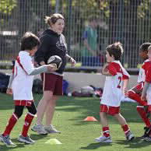
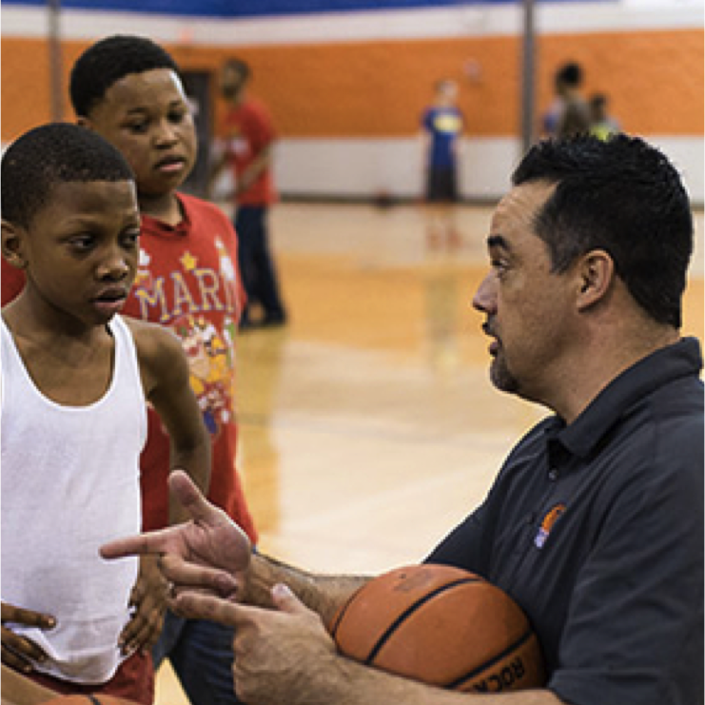
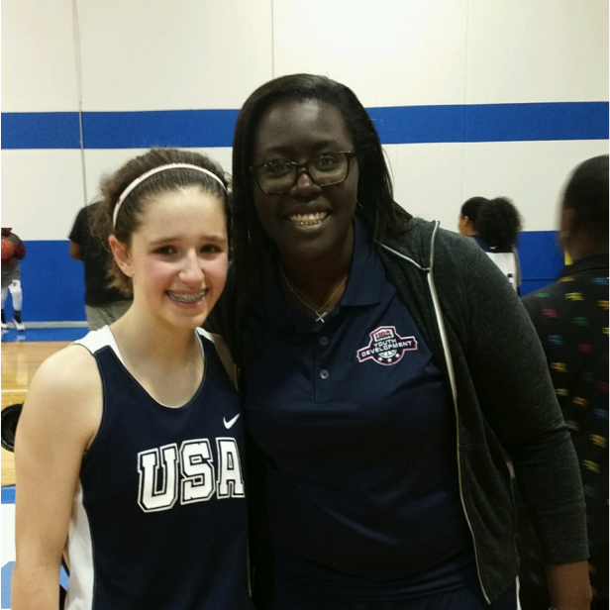
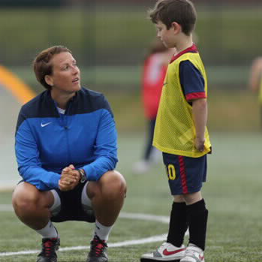
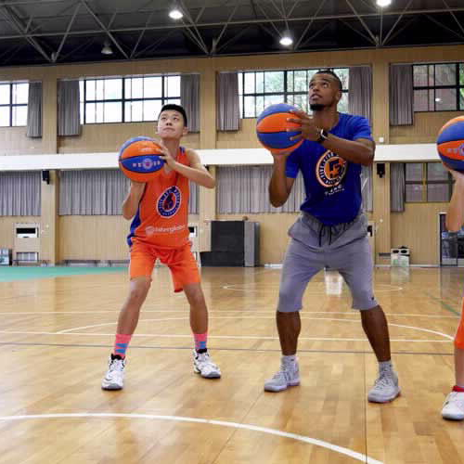
Express Care
Expand Possibilities
Provide Support
Share Power
Challenge Growth
Notes:
2 minutes (92; 86; 98 minutes)
Through the research, Search institute has identified 5 things that a young person needs to thrive.
The question becomes- how do we ensure that all young people have the adults they need to carry out these 5 activities?
Please note: This discussion needs to focus on the fact that young people already have adults in their lives and that although some adults may not be able to carry out all the activities- we should never discount what the adults CAN do- for instance, we want to get away from the notion that young people “have no one”. They may have someone who can love them and believe in them but this may not lead to opportunities to help them achieve academically. Always celebrate what the adults can offer.

Slide 15
Express Care
Adults are dependable: spend time
Adults listen
Adults believe in young people
Adults are warm: showing that they enjoy spending time with young people
Adults encourage: praise young people for their effort and accomplishments
Notes:
3 minutes (95; 89; 101 minutes)
Review the specifics of each of the 5 elements of the developmental relationships framework.

Slide 16
Adults navigate: guiding young people through hard situations and systems
Adults empower: build young people’s confidence
Adults advocate on behalf of young people
Adults set boundaries: putting in place limits that keep them on track
Provide Support
Notes:
3 minutes (98; 92; 104 minutes)
Review the specifics of each of the 5 elements of the developmental relationships framework.

Slide 17
Adults expect the best of young people
Adults stretch: push young people to go further
Adults hold young people accountable
Adults help young people reflect on failures
Challenge Growth
Notes:
3 minutes (101; 95; 107 minutes)
Review the specifics of each of the 5 elements of the developmental relationships framework.

Slide 18
Adults respect young people: taking them seriously and treating them fairly
Adults include young people: involving them in the decisions that affect them
Adults collaborate with young people: working with them to solve problems and reach goals
Adults let young people lead
Share Power
Notes:
3 minutes (104; 98; 110 minutes)
Review the specifics of each of the 5 elements of the developmental relationships framework.

Slide 19
Adults inspire young people to see possibilities
Adults broaden horizons exposing them to new ideas, experiences and places
Adults connect young people to others who can help them develop and thrive
Expand Possibilities
Notes:
3 minutes (107; 101; 113 minutes)
Review the specifics of each of the 5 elements of the developmental relationships framework.

Slide 20
Express Care
Expand Possibilities
Provide Support
Share Power
Challenge Growth
Notes:
1 minute (108; 102; 114 minutes)
Now that we know the key elements of the kinds of relationships that help young people thrive, it’s time to think about the HOW. How do we make these things come alive in our sports context. How can we be more intentional about what we do to ensure that we are doing all of these things.

Slide 21
WHAT YOU
SAY
WHAT YOU
DO
EXPRESS
CARE
PROVIDE SUPPORT
CHALLENGE GROWTH
SHARE
POWER
EXPAND POSSIBILITIES
Notes:
10 minutes (5 working, 5 debrief) (118; 112; 124 minutes)
In groups of 2 or 3- don’t be by yourself and don’t be in a big group of 4- think about the things that you are already doing that express care, provide support, challenge growth, share power, and expand possibilities. Think about them as the things that you can actually SAY, the things that you consistently DO and the ways in which you make these things happen for the whole team- not only in one on one interactions.
Feel free to write as much down as you can. We’ll have a chance to chat about some of these once you’ve thought about it for a bit.
Have partners or trios share their strategies. Push them to be clear about how they think it achieves the element of the developmental relationship they are addressing.

Slide 22
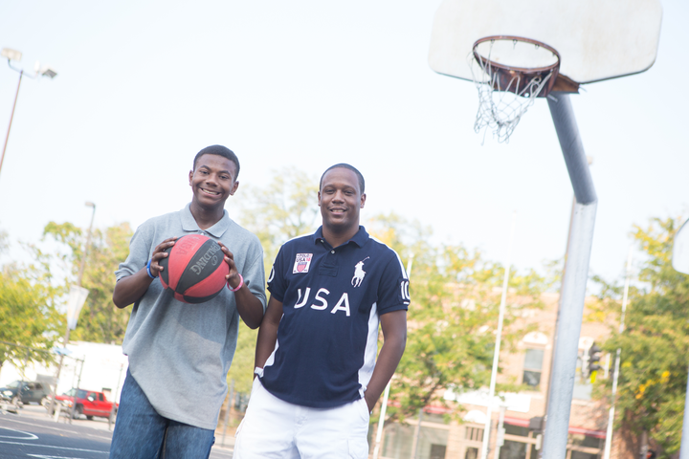
WHAT WILL YOU DO?
Notes:
5 minutes (158; 152; 164 minutes)
Commitments and closing- pair share
Ask folks to come up with one thing they want to try after this training. Encourage them to say it out loud to their partner, write it down in their workbook, and share it with the whole group in order to really make it real!

Slide 23
Ask Questions & Set Boundaries
Don’t be afraid to get to know them
Don’t be afraid to let them get to know you
Boundaries go both ways, we have to know where they begin and where they end
“I see you”

Slide 24
IMPORTANT RESOURCES
www.mentoring.org
Program Resources
EEP Tools & Toolkit
www.nationalmentoringresourcecenter.org/
NMRC- TA
https://connect.mentoring.org/
Mentor Connector
NQMS (National Quality Mentoring System)

Slide 25
For more information, please contact:
Jack Kavanaugh
Mentor New York
www.mentornewyork.org
716-855-0007 ext 323
jkavanaugh@mentorkids.org

